Slide 1
Predicting Ford stock VaR
Artem Kulik

Slide 2

Agenda
State of the Art of data analysis
2. Project phases
3. Predictions
4. Conclusion
Agenda
Agenda

Slide 3
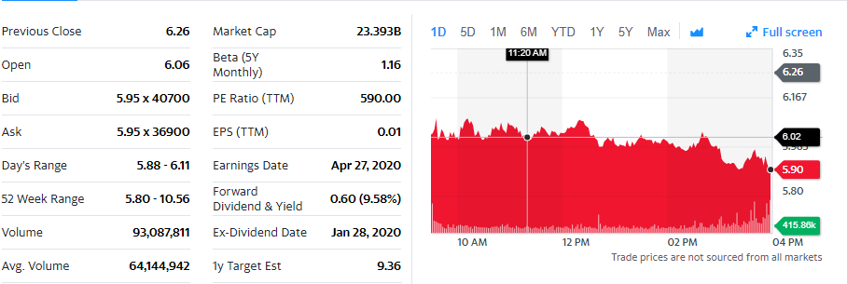
State of the Art
Yahoo finance provides data for each company stock value
https://finance.yahoo.com/quote/F/history?p=F

Slide 4

Objectives : implement algorithm predicts return value

Slide 5
Phases
Step 4
Step 3
Step 2
Step 1
Result observation
Model selection
Data analysis, feature analytics
Data extracting and preprocessing

Slide 6
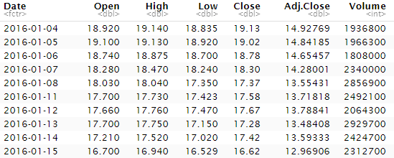
Data extraction
Data:
Table:
3 datasets from 3 companies: Ford, Gazprom and UBS during the period 2016-01-01 – 2020-01-01
7 columns per each dataset (Date, Open, High, Low, Close, Adj.Close, Volume)
1006 instances

Slide 7
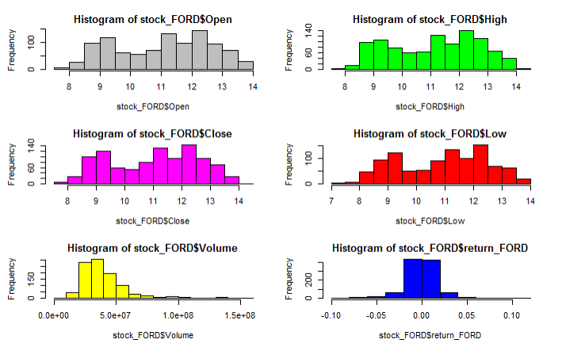
Feature distribution
Table:

Slide 8
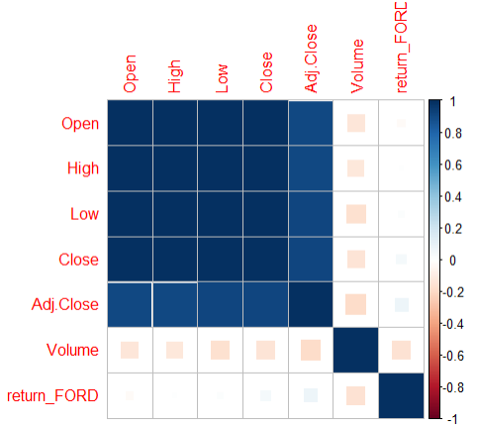
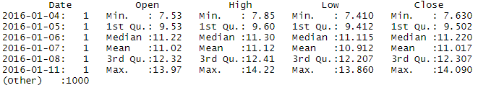
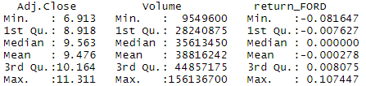
Data properties:
Correlation Map: cor(stock_FORD[-1])
stock_FORD$return_FORD = stock_FORD$Close / shift(stock_FORD$Close, fill = stock_FORD$Close[1]) - 1

Slide 9
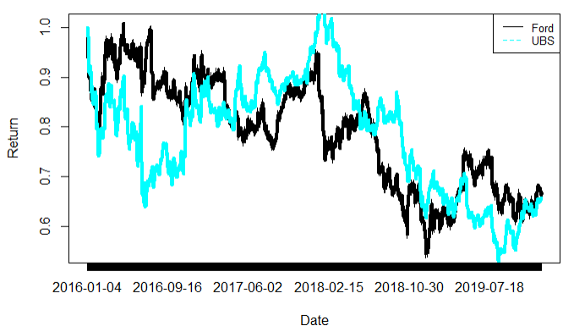
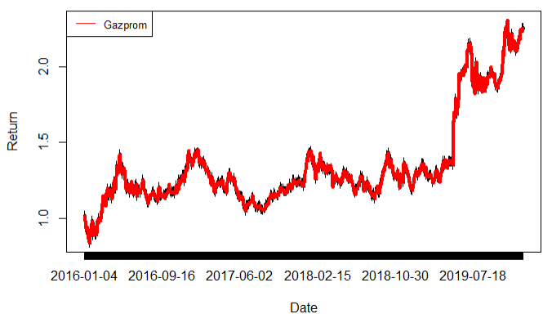
“Return” feature
Cumulative function of return

Slide 10
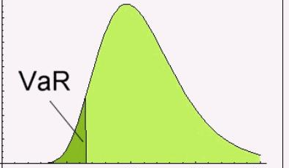
VaR
Value at risk (VaR) is a measure of the risk of loss for investments. It estimates how much a set of investments might lose (with a given probability), given normal market conditions, in a set time period such as a day.
In our case VaR is 5% quantile

Slide 11
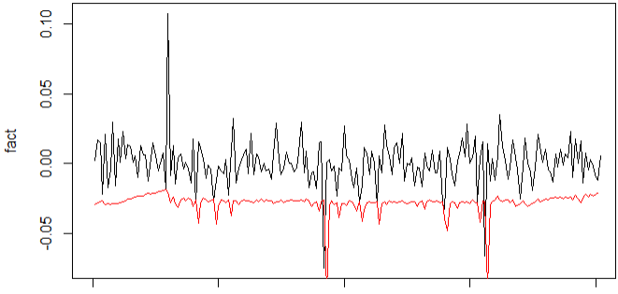
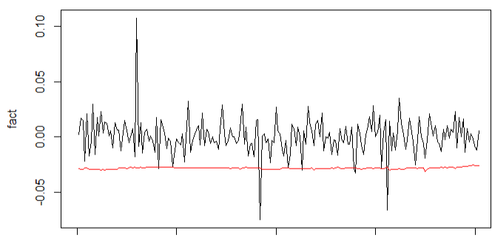
Modelling
ARMA-GARCH model
Generalized hyperbolic distribution
VaR(mean) : -0.024493
Data was fragmented:
80% - Train
20% - Test

Slide 12


Conclusion
Results
1
Data research
2
Applying the results on different models and distributions
3
Model comparison

